Slide 1

ICEG
Open Standards
September, 13th 2019
Wifi: bosa-guest, connect2bosa

Slide 2
Content
Roundtable: who’s who ?
Why are we here ?
Github
Inventory of what we already have
Thematic workgroup on URI
Calendar for the rest of 2019
Roundtable: reactions, topics of interest

Slide 3
1. Roundtable: who’s who ?
https://github.com/belgif/review = public site
GDPR issue or not ?

Slide 4
2. Why are we here?

Slide 5
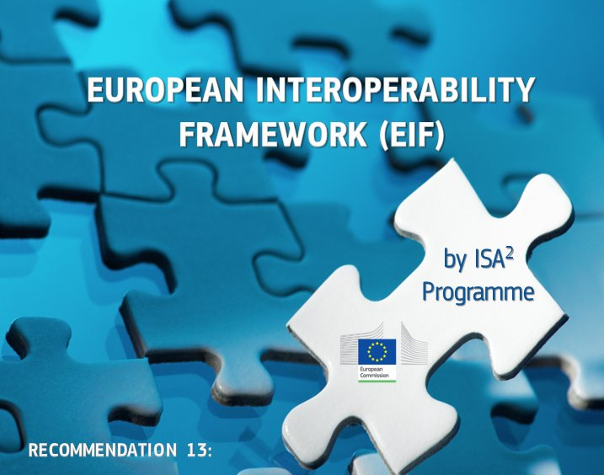

European context – Once Only
Open Standards for Linked Organisations

Slide 6

Local Governments - Once-Only
> 250 Information Systems
Local government
> 1000 public services
# administrations
Open Standards for Linked Organisations

Slide 7
Interoperability levels
Legal interoperability aligned and digital friendly legislation
Political Context
Political, cultural and structural conditions
Organisational interoperability optimised processes by/for optimised data exchange
Semantic interoperability meaning, structure and appropriate use of information
Technological interoperability technical issues involved in linking computer systems
European Interoperability Framework (EIF)

Slide 8
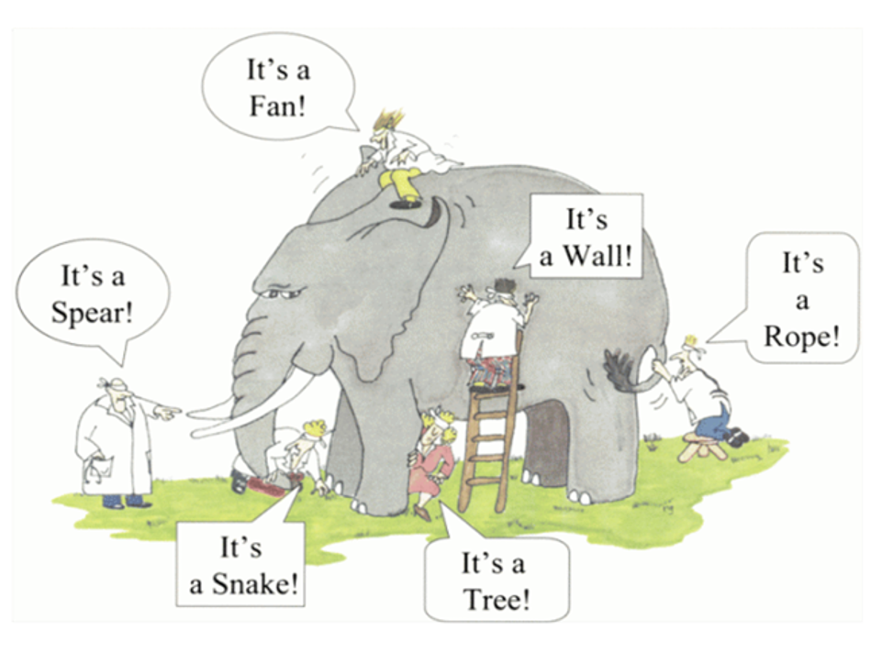
Context neutral information
applications look at the ‘real world’ from different perspectives
information is structured/modelled from one perspective
authoritative sources exist as independent silo’s
impact on the quality and the efficiency of public services.
multiple investments for interlinking data

Slide 9
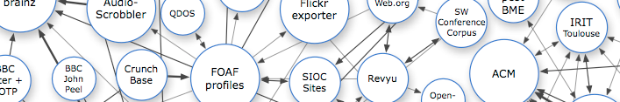




Share and Re-use
W3C
International Standards
EU
Vocabularies
Interfederal
Regional Extentions
EU - ISA²
Federal Government
Regional Government
Local Government
Industry
Academia
OSLO
PERSON VOCABULARY
OSLO
BUSINESS VOCABULARY
OSLO
ROAD VOCABULARY
OSLO
ORGANISATION VOCABULARY
OSLO
DCAT-AP VL VOCABULARY
OSLO
ROAD VOCABULARY
OSLO
ORGANISATION VOCABULARY
Interfederal knowledge graph

Slide 10
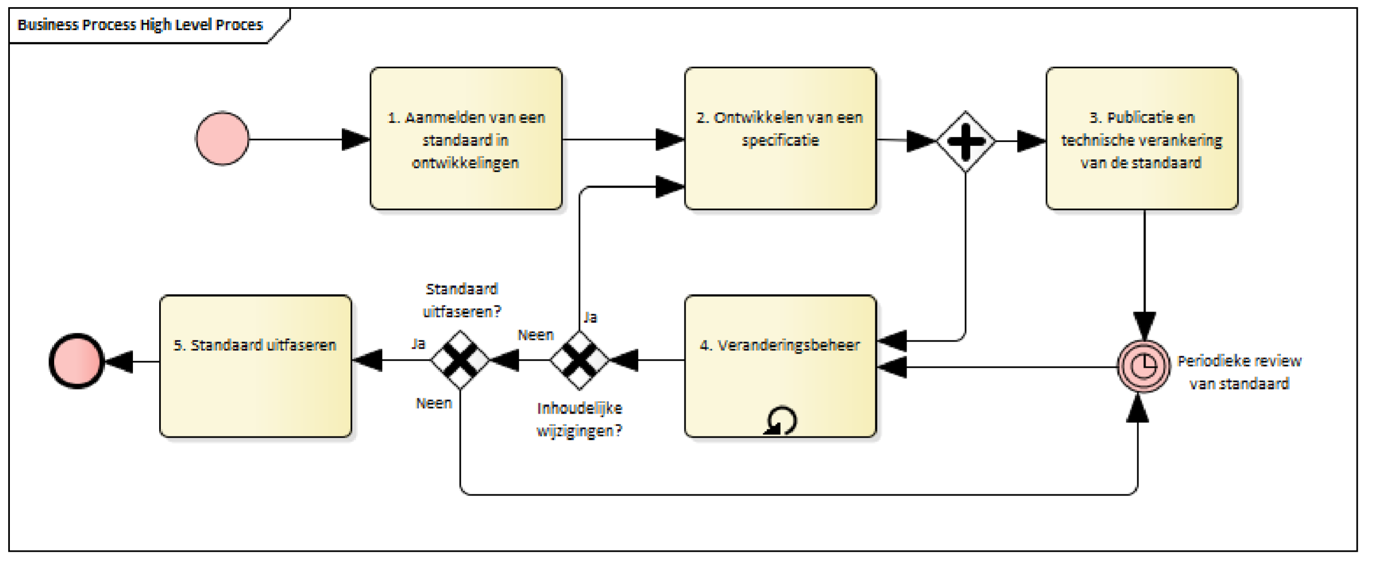
Process and method
W3C, IEEE, IETF, IAB en ISA, Open Stand, OSLO

Slide 11

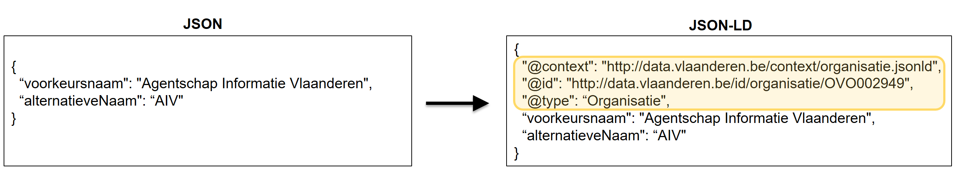
Machine readable?
The context of the conversation

Slide 12
End-2-End governance
INTERFEDERAL GOVERNANCE
GOVERNANCE
ICEG
REVIEW GROUP
COLLABORATION
THEMATIC WORKING GROUPS
STAKEHOLDERS
LOGICAL DATA MODEL
SHACL RULES
SPECIFICATION
DOCUMENTATION
GUIDANCE
DOCUMENTATION
VOCABULARY (RDF)
JSON-LD CONTEXT

Slide 13
Mission statement and roles
The Strategic Steering Committee (ICEG) intends to establish agreements on the development and application of datastandards and related specifications. These agreements aim to raise the interoperability between the European, federal, regional, communital and local authorities.

Slide 14
Mission statement and roles
The review group ‘open standards’ has a permanent character and is responsible for the central coordination and follow-up of the work related to the standardisation of information.
The work falls under the standardisation of:
meaning of the information (semantic),
syntax (grammar) and technical standards for the exchange of the information
metadata for discoverability ('data on data’).
In addition, the working group monitors
mutual consistency of standards,
international standards that impact governments in Belgium
generic development and the change process.
The working group on data standards gathers on a regular basis.

Slide 15
Roadmap
Define the revised mission in the collaboration agreement between the federal, regional and community authorities (dd. 2013-08-26).
Agree on the high-level roadmap.
Agree on the financing of the review group (roles: working group leader, semantic expert, technical expert, project manager, toolsmith and translation).
Establish the Governance Structure (review group).
Validate the process and method.
Agree on the priorities
Initiate the thematic working groups

Slide 16
3. Github
https://github.com/belgif/review
https://github.com/belgif/thematic
Add issues/comments to Github – how ?

Slide 17
3. Github
https://github.com/belgif/review
https://github.com/belgif/thematic
By default everything public (read-only)
Adding issues/comments to Github:
Create a (free) account on Github.com
Notify BOSA (Bart, Marc) to get write-access

Slide 18
3. Github (continued)
Features:
Versioning of files
Tickets / TODO lists
Tools:
Github web interface
Or command-line tool git
Or desktop (https://desktop.github.com/)

Slide 19
4. Inventory of what we already have
Federal vocabularies https://github.com/belgif/fedvoc
OSLO2 https://data.vlaanderen.be
Other material ?

Slide 20
Open Standards for Linked Organisations (OSLO)
1
30
300+
3000+
Governance
Domain models
Contributors
Definitions
Notes:
What

Slide 21
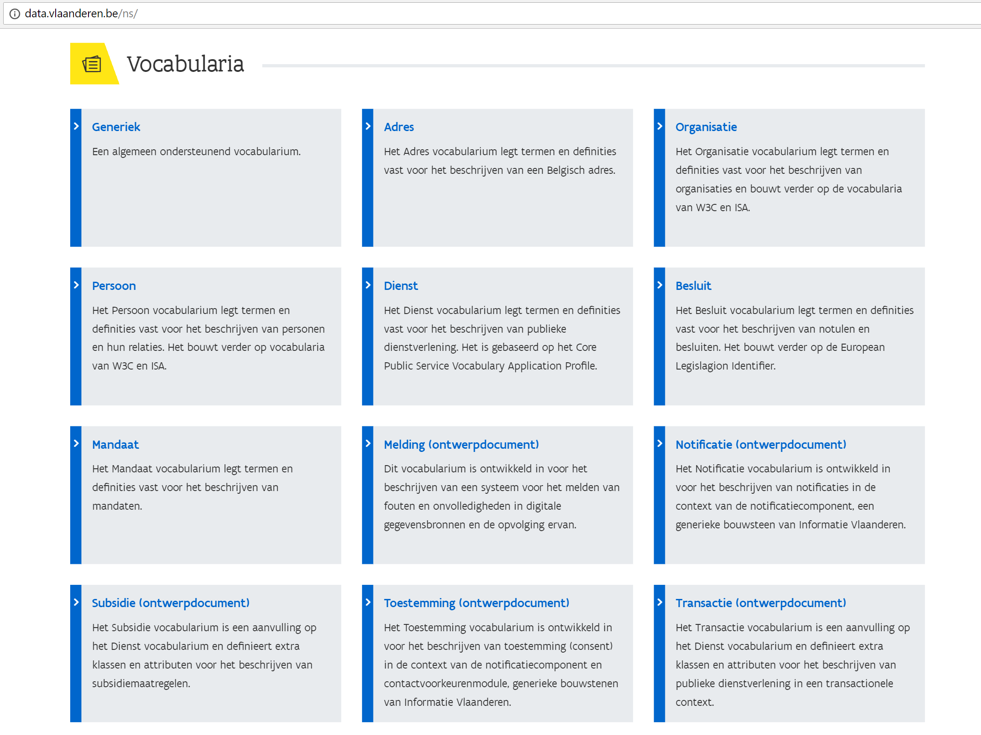
Data.Vlaanderen.be
Publishing of normative semantic assets (vocabularies, application profiles, code lists)
Publishing of non-normative guidelines (JSON-LD context, SHACL)
http://data.vlaanderen.be/ns/
Notes:
What

Slide 22
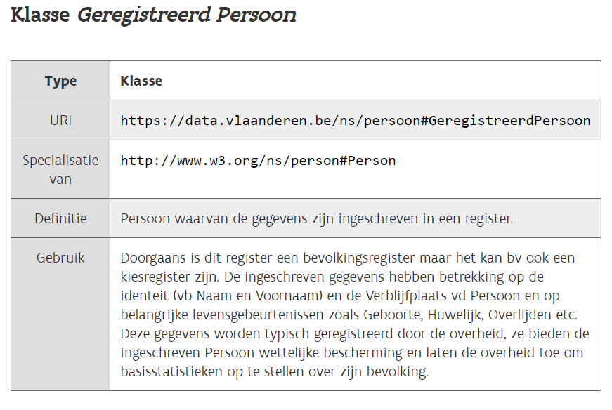
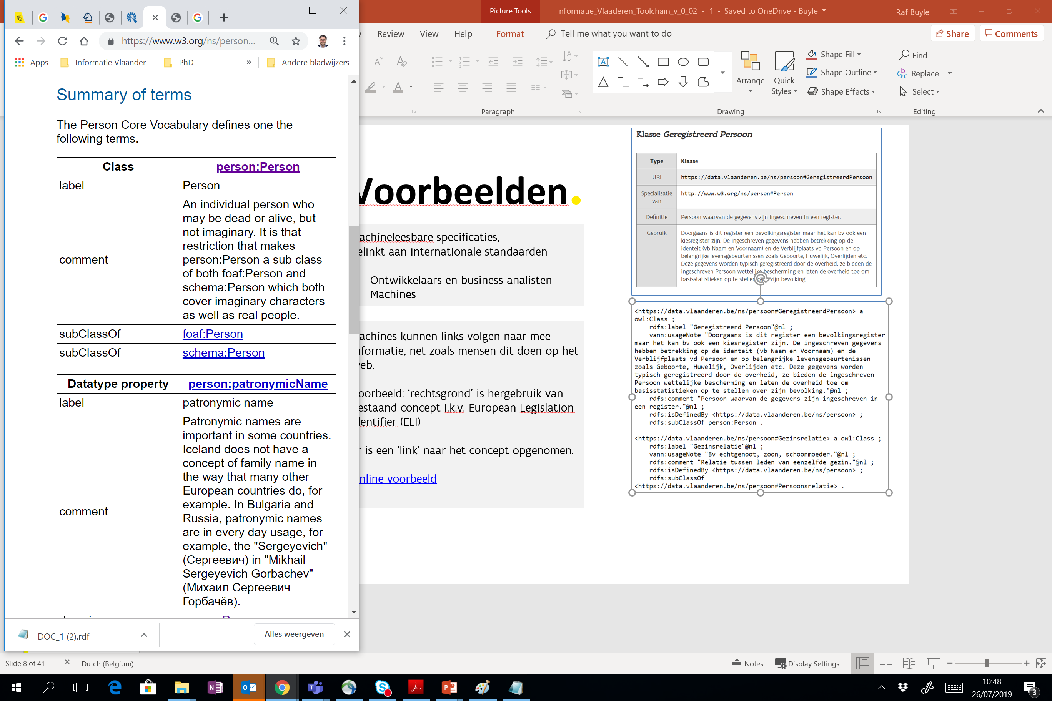
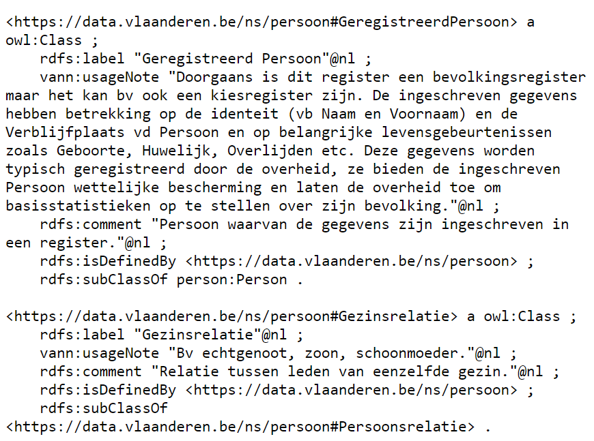
Data.Vlaanderen.be
HUMAN- and machine readable
Human and machine alignment
Content negotiation
Linked to international standards (reuse first)
http://data.vlaanderen.be/ns/persoon
Notes:
What
Human & machine vb: AMDS

Slide 23
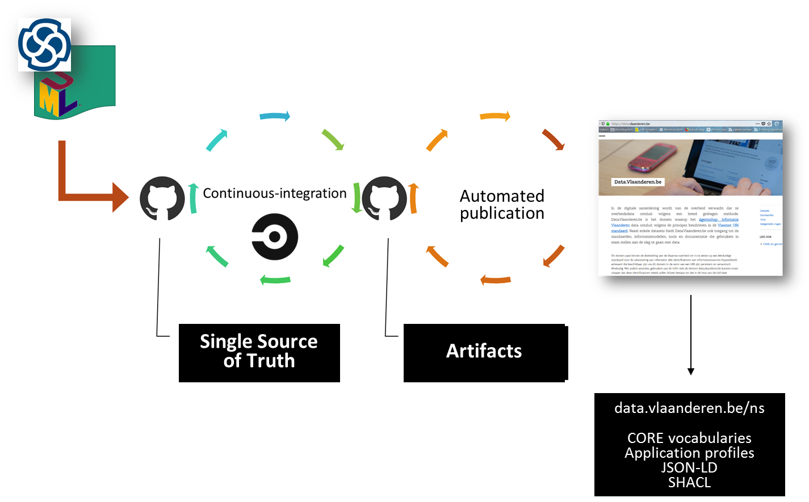
Oslo toolchain
Notes:
Open Source toolstack

Slide 24
4. Inventory of what we already have
Federal vocabularies https://github.com/belgif/fedvoc
OSLO2 https://data.vlaanderen.be
Other material ?

Slide 25
5. Thematic workgroup on URI

Slide 26
5. Thematic workgroup on URI
https://github.com/belgif/thematic
https://github.com/belgif/thematic/tree/master/URI
Project charter
Invite experts

Slide 27
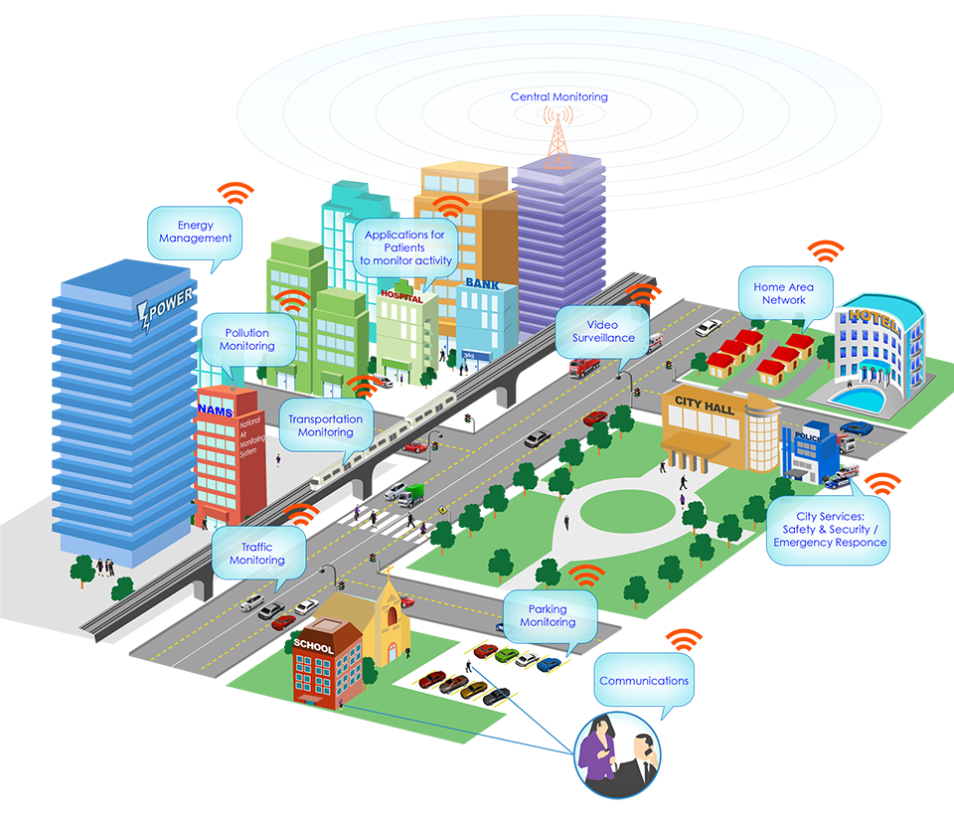
Roadmap 2019: URIs The Web as a Blueprint
5. Thematic workgroup on URI
Persistent Identifiers: URIs
Dereferenceable HTTP URIs
Standardised Information (RDF)
Links to other information

Slide 28
What’s a URI ? What does it solve ?
To combine data, we need:
Unique identifiers (like primary keys)
It would be nice if:
They would be globally unique
There would be an easy way to look them up
Preferably over the web

Slide 29
What’s a URI ? What does it solve ? (2)
A solution looks very much like a link or URL
Domain names / paths to make IDs unique
HTTP to retrieve webpages on whatever site
So let’s reuse that !
… with some agreed upon rules.

Slide 30
What’s a URI ? What does it solve ? (3)
They are (sort of a) Universal Resource Identifier
They have to be stable (persistent)
Published once is published forever
They don’t have to point to an existing page
but if they do, the pages should be machine readable

Slide 31
6. Calendar for the rest of 2019
13 Sep: meeting 1 review group (organizer BOSA)
11 Oct (10-12hr): meeting 2 review group (organizer Flanders)
Process and methods ratification by ICEG (organizer ICEG secretariat)
11 Oct (14-16hr): meeting 1 thematic wg URI (organizer CFWB)
8 Nov: meeting 2 thematic wg URI (organizer BOSA)
22 Nov: meeting 3 thematic wg URI (organizer Flanders)
30/11-31/1 public review URI
(organizer takes care of invitation, meeting room, minutes of meeting)

Slide 32
7. Roundtable: reactions, topics of interest

